Slide 1
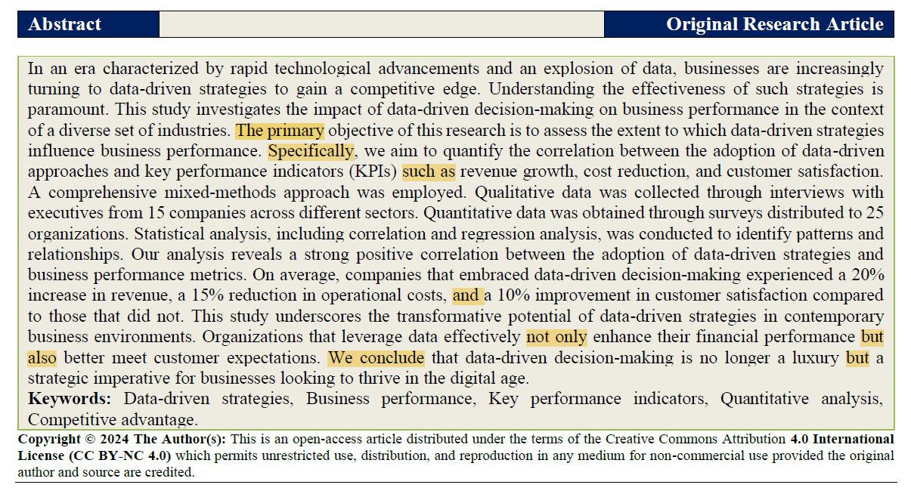

Slide 2

If the primary objective is to assess the extent data driven strategies influence business perfomances, what is the secondary one?
Can you replace such as to another connective? Which one would you use?
What is the meaning of the sentence “This study underscores the transformative potencial of data-driven strategies and business performance metrics”?
What is the difference between a qualitative and a quantitative analysis?

